Slide 1




Ministry of Electronics and
Information Technology
Government of India
Ministry of Electronics and
Information Technology
Introduction to
Intel Vtune Profiler
Jayashri Pawar
HPC-Tech Department
CDAC, Pune

Slide 2
What is Profiler?
Performance tools designed to help you to analyze the performance of application and improve poorly performing sections of code.
Provide measurements of how long a routine takes to execute, how often it is called, where it is called from, and how much of total time at some spot is spent executing that routine.

Slide 3


What is Vtune?
Intel VTune Amplifier is a performance analysis tool for users developing serial and multithreaded applications
VTune Amplifier helps you analyze the algorithm choices and identify where and how your application can benefit from available hardware resources.
VTune Amplifier includes both a graphical user interface (GUI) and a command line (CL) interface that can be accessed with
vtune-gui
vtune-cl
A central processing unit (CPU) gets instructions and/or data from memory, decodes the instructions and then sequentially performs them.

Slide 4
VTune Profiler is used to locate or determine:
The most time-consuming (hot) functions in your application and/or on the whole system
Sections of code that do not effectively utilize available processor time
The best sections of code to optimize for sequential performance and for threaded performance
Synchronization objects that affect the application performance
Whether, where, and why your application spends time on input/output operations
Whether your application is CPU or GPU bound and how effectively it offloads code to the GPU
The performance impact of different synchronization methods, different numbers of threads, or different algorithms
Thread activity and transitions
Hardware-related issues in your code such as data sharing, cache misses, branch misprediction, and others

Slide 5
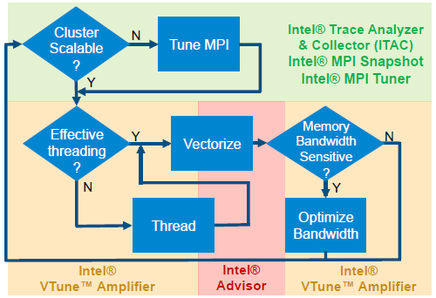
Purpose Of Intel Tools

Slide 6
Start the VTune Profiler
Set up the environment variables:
csh/tcsh users: source <install_dir>/amplxe-vars.csh
bash users: source <install_dir>/amplxe-vars.sh
Example:
source /opt/ohpc/pub/syssoftware/intel/2018/vtune_amplifier_2018/amplxe-vars.sh
Launch the VTune Profiler:
For standalone GUI interface, run the amplxe-gui command.
For command line interface, run the amplxe-cl command.

Slide 7
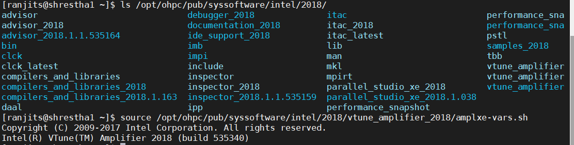
Intel tools PATH

Slide 8
Vtune Command Syntax
amplxe <-action> [-action-option] [-global-option] [[--] <target> [target-options]]
Example :
amplxe-cl -collect hotspots -result-dir r001hs /home/test/sample
-collect is an action
hotspots is an argument of the action
-result-dir is an action-option
r001hs is an argument of the action-option
sample is a target

Slide 9
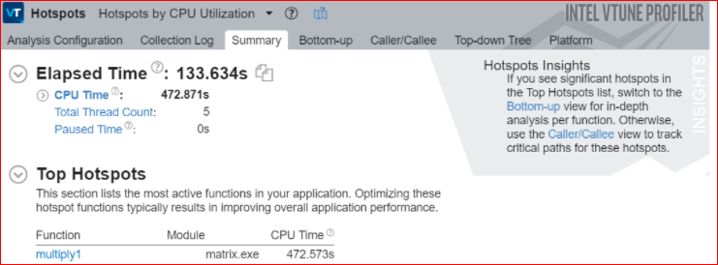
Important analysis types
Hotspots Analysis for CPU Usage Issues
Hotspots analysis to understand an application flow and identify sections of code that get a lot of execution time (hotspots). This is a starting point for your algorithm analysis.

Slide 10
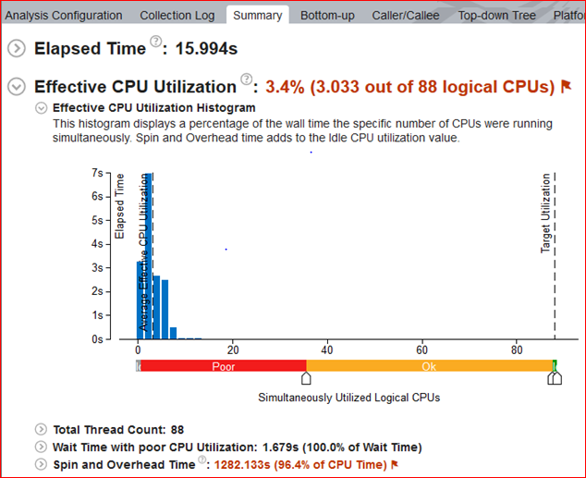
Threading Analysis
Use the Threading analysis to identify how efficiently an application uses available processor compute cores and explore inefficiencies in threading runtime usage or contention on threading synchronization that makes threads waiting and prevents effective processor utilization.

Slide 11
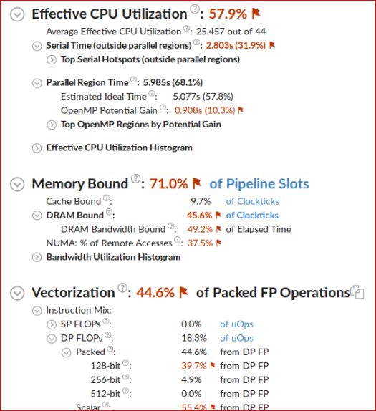
HPC Performance Characterization Analysis
Use the HPC Performance Characterization analysis to identify how effectively your compute-intensive application uses CPU, memory, and floating-point operation hardware resources.

Slide 12
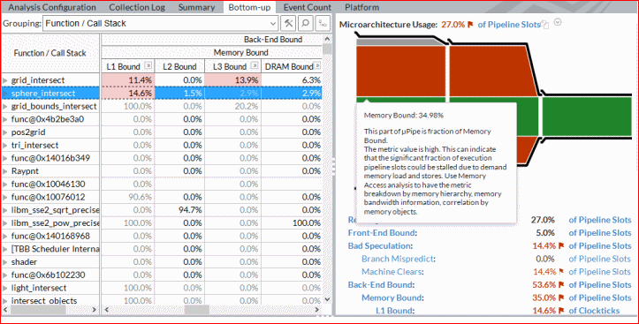
Microarchitecture Exploration Analysis for Hardware Issues
Perform Microarchitecture Exploration analysis to understand how efficiently your code is passing through the core pipeline.

Slide 13
Pipeline slots divided into following categories:
Pipeline slots containing useful work that issued and retired (Retired)
Pipeline slots containing useful work that issued and cancelled (Bad speculation)
Pipeline slots that could not be filled with useful work due to problems in the front-end (Front-end Bound)
Pipeline slots that could not be filled with useful work due to a backup in the back-end (Back-end Bound)
Memory Bound metric that shows a fraction of cycles spent waiting due to demand load or store instructions

Slide 14
Memory Access Analysis for Cache Misses and High Bandwidth Issues
Memory Access analysis type uses following metrics:
Loads and Stores metrics that show the total number of loads and stores
LLC Miss Count metric that shows the total number of last-level cache misses
Local DRAM Access Count metric that shows the total number of LLC misses serviced by the local memory
Remote DRAM Access Count metric that shows the number of accesses to the remote socket memory
Remote Cache Access Count metric that shows the number of accesses to the remote socket cache

Slide 15
L1 Bound metric that shows how often the machine was stalled without missing the L1 data cache
L2 Bound metric that shows how often the machine was stalled on L2 cache
L3 Bound metric that shows how often the CPU was stalled on L3 cache, or contended with a sibling core
L3 Latency metric that shows a fraction of cycles with demand load accesses that hit the L3 cache under unloaded scenarios (possibly L3 latency limited)
NUMA: % of Remote Accesses metric shows percentage of memory requests to remote DRAM. The lower its value is, the better.

Slide 16
VTune Profiler provides features that facilitate the analysis and interpretation of the results:
Top-down tree analysis: Use to understand which execution flow in your application is more performance-critical.

Slide 17
Matrix multiplication:(Serial)
#include <stdio.h>
#include <stdlib.h>
#define N 3000
float a[N][N], b[N][N], c[N][N];
void matmul(void)
{
int i, j, k;
for(i=0; i<N; i++)
{
for(j=0; j<N; j++)
{
c[i][j] = 0.0f;
for(k=0; k<N; k++)
c[i][j] = c[i][j] + a[i][k] * b[k][j];
}
}
}

Slide 18
Serial compilation
Command for compilation:
time icc -g -O3 matmul.c -o matmul.serial
Intel compiler
With -g option, the resulting object file will contain debugging information
-O3 option optimizes for maximum speed

Slide 19
Run Basic Hotspots analysis
Basic Hotspots analysis help to understand application flow and identify sections of code that get a lot of execution time (hotspots)
Command :
time amplxe-cl -c hotspots -r res_serial ./matmul.serial
Result Directory
Executable file
Result : To open result in GUI mode
amplxe-gui res_serial.amplxe

Slide 20
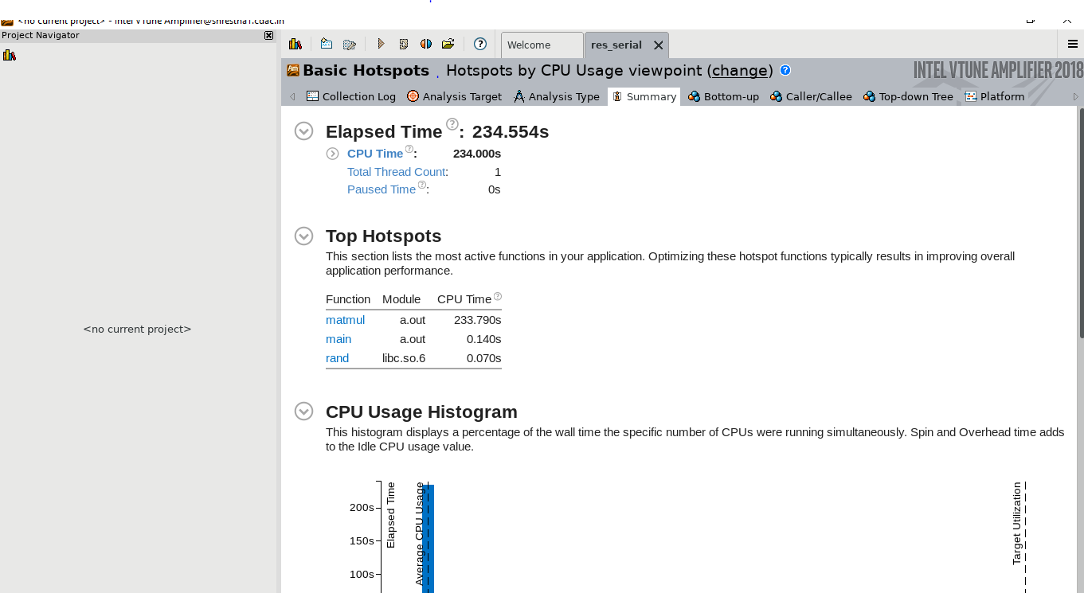
Analysing Serial output

Slide 21
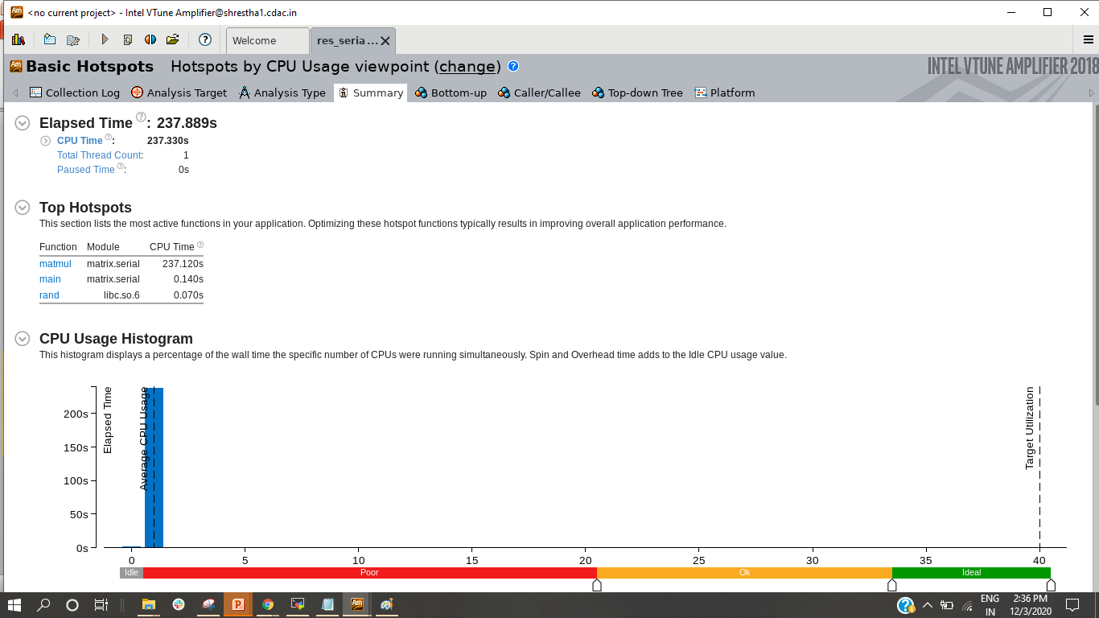
Cont …

Slide 22
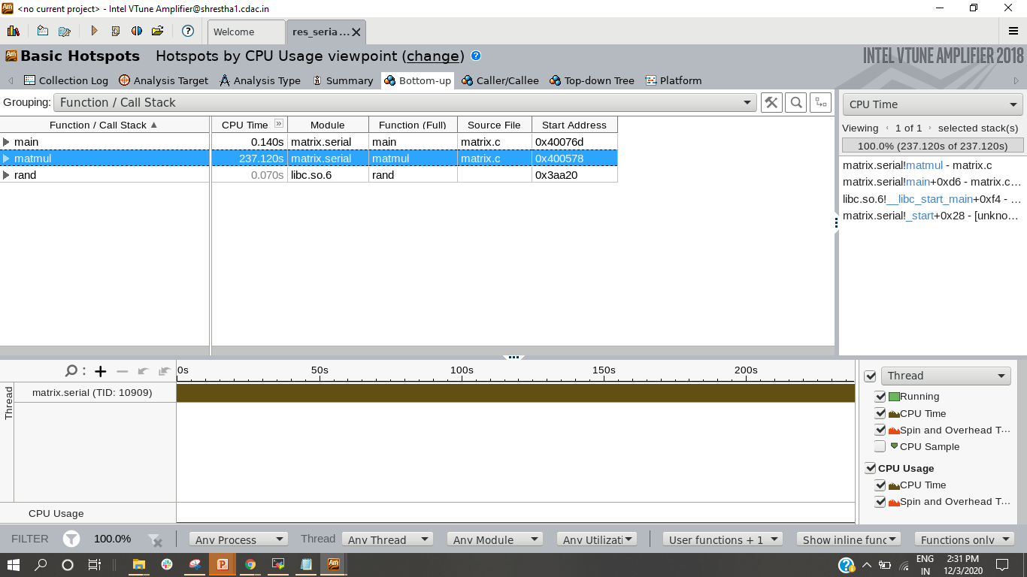
Cont …

Slide 23
Matrix multiplication:(parallel)
float a[N][N], b[N][N], c[N][N];
void matmul(void)
{
int i, j, k;
#pragma omp parallel for
for(i=0; i<N; i++)
{
for(j=0; j<N; j++)
{
c[i][j] = 0.0f;
for(k=0; k<N; k++)
c[i][j] = c[i][j] + a[i][k] * b[k][j];
}
}
}

Slide 24
Parallel compilation
time icc -g -O3 -qopenmp matrixomp.c -o matrix.parallel
O3 Enable -O2 optimizations and in addition, enable more aggressive optimizations such as loop and memory access transformation, and prefetching.
The -O3 option optimizes for maximum speed, but may not improve performance for some programs. The -O3 optimizations may slow down code in some cases compared to -O2 optimizations.
Recommended for applications that have loops with heavy use of floating point calculations and process large data sets.

Slide 25
Run Basic Hotspots analysis
Basic Hotspots analysis help to understand application flow and identify sections of code that get a lot of execution time (hotspots)
Command : time amplxe-cl -c hotspots -r res_parallel ./matmul.parallel
Result Directory
Executable file
Result : To open result in GUI mode
amplxe-gui res_parallel.amplxe

Slide 26
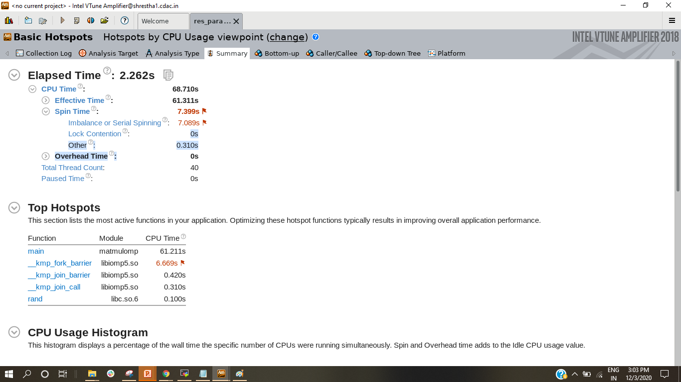
Analysing Serial output

Slide 27
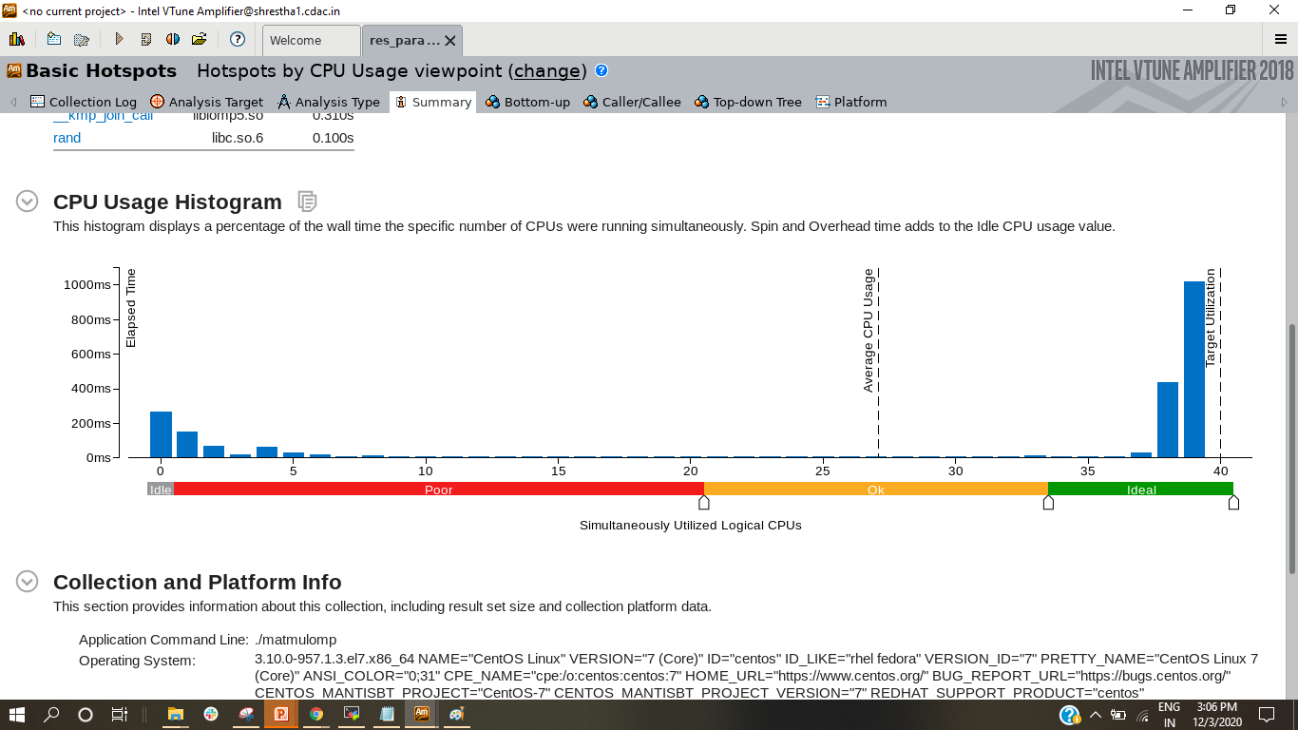
Cont …

Slide 28
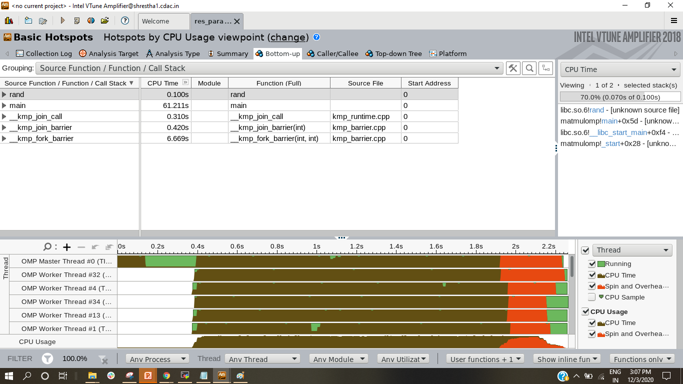
Bottoms-UP

Slide 29
Third Implementation
void matmul(void)
{
int i, j, k;
#pragma omp parallel for collapse (2)
for(i=0; i<N; i++)
{
for(j=0; j<N; j++)
{
c[i][j] = 0.0f;
for(k=0; k<N; k++)
c[i][j] = c[i][j] + a[i][k] * b[k][j];
}
}
}

Slide 30
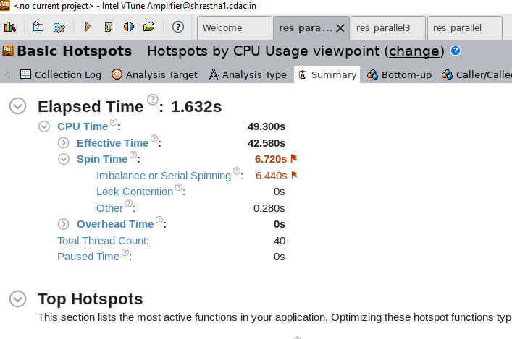
Output

Slide 31
Forth Implementation
void matmul(void)
{
int i, j, k;
#pragma omp parallel for collapse (2)
for(i=0; i<N; i++)
{
for(j=0; j<N; j++)
{
#pragma ivdep
for(k=0; k<N; k++)
c[i][j] = c[i][j] + a[i][k] * b[k][j];
}
}
}

Slide 32
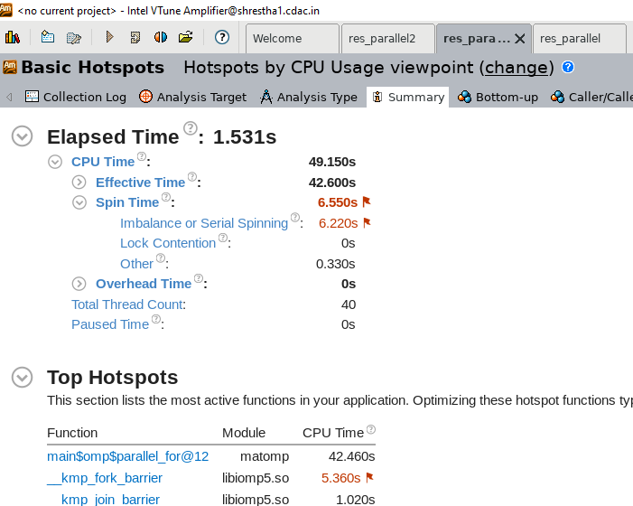
OUTPUT

Slide 33
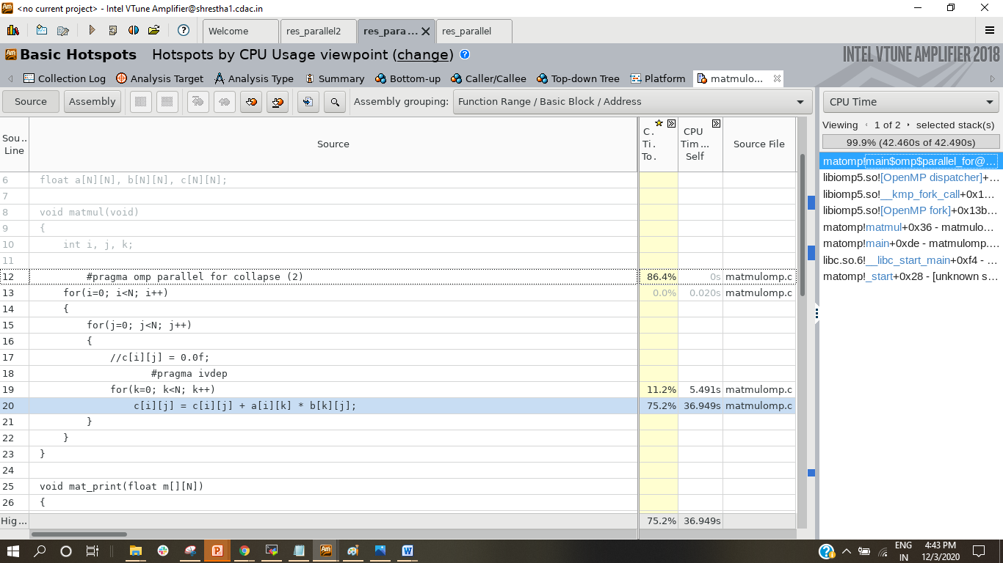
Cont …

Slide 34
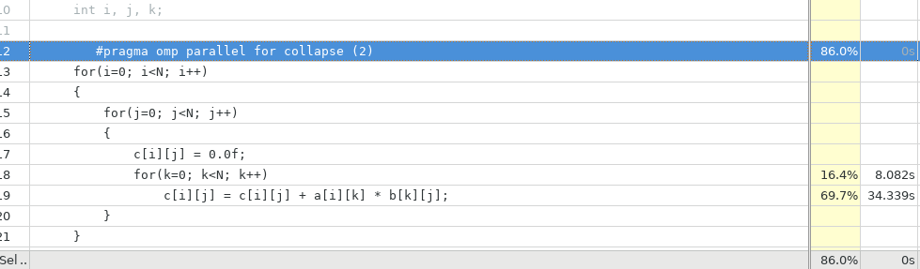
Cont …

Slide 35
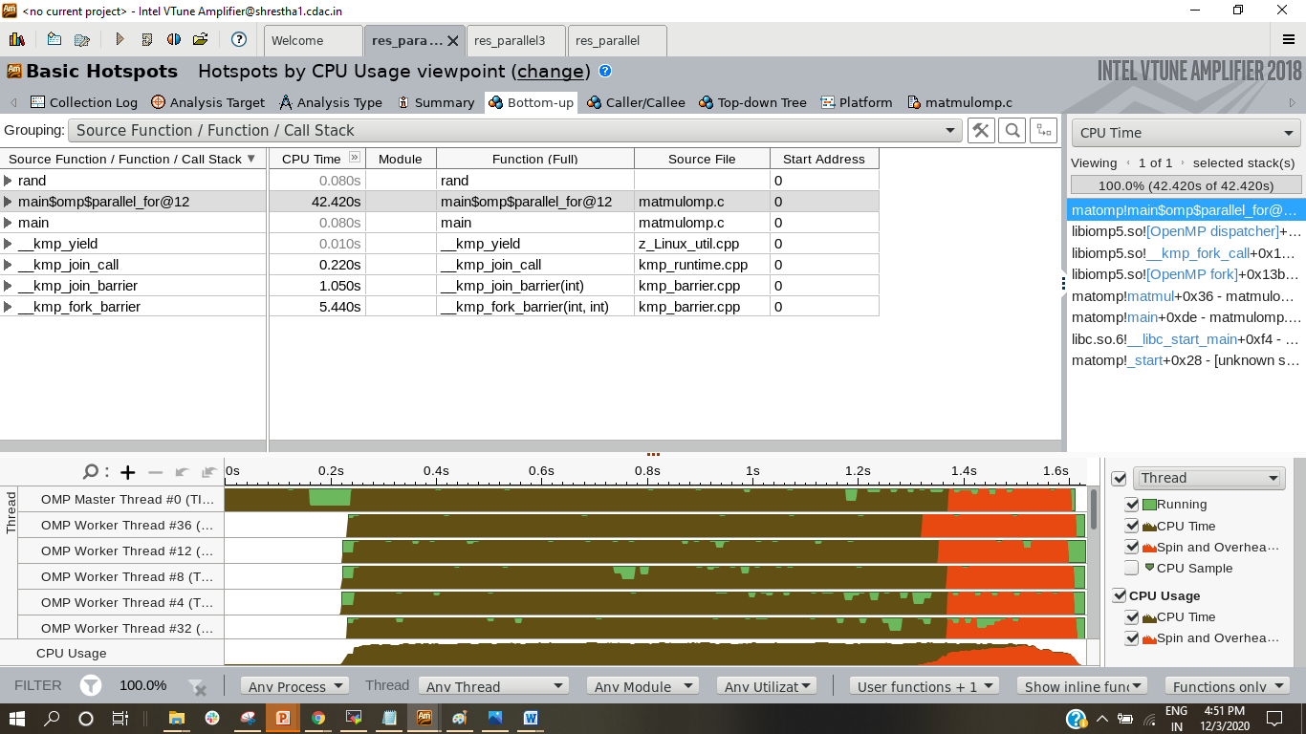
Cont…

Slide 36
Fifth Implementation
float a[N][N], b[N][N], c[N][N];
void matmul(void)
{
int i, j, k;
#pragma omp parallel for collapse (2)
for(i=0; i<N; i++)
{
for(j=0; j<N; j++)
{
#pragma unroll(8)
#pragma ivdep
for(k=0; k<N; k++)
c[i][j] = c[i][j] + a[i][k] * b[k][j];
}
}
}

Slide 37
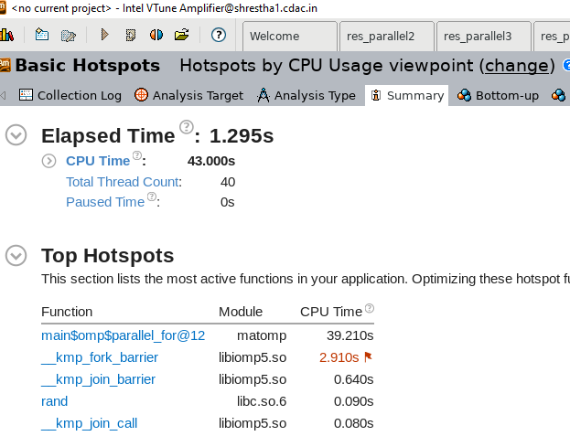
Output

Slide 38
Overall Analysis
Serial Number | Runs | Timings in seconds(sec)
1 | Basic Serial | 237.889
2 | Basic Parallel | 2.262
3 | Third Implementation | 1.632
4 | Fourth Implementation | 1.531
5 | Final | 1.295

Slide 39
Intel Trace Analyzer and Collector
Intel Trace Analyzer and Collector profiles and analyzes MPI applications to help focus your optimization efforts.
Find temporal dependencies and bottlenecks in your code.
Check the correctness of your application.
Locate potential programming errors, buffer overlaps, and deadlocks.
Visualize and understand parallel application behavior.
Evaluate profiling statistics and load balancing.
Analyze performance of subroutines or code blocks.
Learn about communication patterns, parameters, and performance data.
Identify communication hot spots.
Decrease time to solution and increase application efficiency.

Slide 40
ITAC is a graphical tool for understanding MPI application behavior, quickly finding bottlenecks, improving correctness, and achieving high performance for parallel cluster applications based on Intel architecture.
Improve weak and strong scaling for small and large applications with Intel Trace Analyzer and Collector.
Trace Collector : enables you to collect statistics for your applications
Trace Analyzer : Provides powerful capabilities for visualizing and analyzing the collected data.

Slide 41
Get Started with ITAC
Set up the environment by sourcing the setvars.sh
Compile with intel compiler icc
Run your MPI application using the mpirun command with the -trace option to generate a trace file:
$ mpiicc -g -trace -o myApp myApp.c
$ mpirun -trace -n 4 ./myApp
A trace file .stf is generated, for example myApp.stf.
Analyze the Application Behavior
Open the generated .stf file in Intel Trace Analyzer:
$ traceanalyzer ./myApp.stf

Slide 42
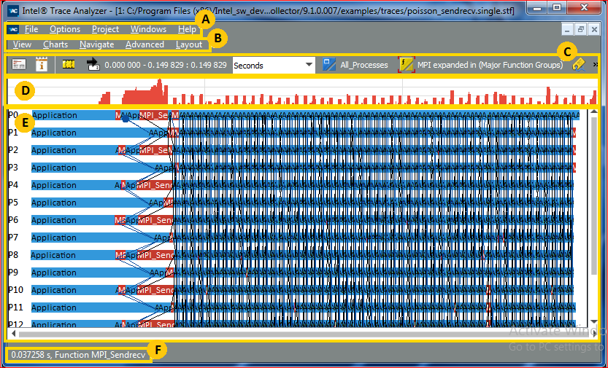
Intel Trace Analyzer GUI

Slide 43
